Slide 1


AMS QUATERLY GOVERNANCE REPORT -
Jan – March 2025(Q1)
Presented to TelevisaUnivision Leadership

Slide 2

CONTENTS
Team Structure
Highlights
SLA Report
AMS Performance
Summary
Domain Dashboard
Appendix

Slide 3
Team Structure
Venkat Pasula
ACCOUNT EXECUTIVE
Sunita Panda
Project Manager
Rosy Ramirez
Program Coordinator
Rohith Pasula
Client Advocate
Sadiq A Moulana
Program Manager
Rakesh Warrier
Service Management Lead
Syed Awaiz
Data Analyst
MICROSOFT SQL SERVER SUPPORT
Mahesh Achanta
(MSSQL Lead DBA
Rafael Bueno
Nearshore Lead DBA
Rakesh Baratam
Lead Oracle/EBS DBA
CORE ORACLE , EBS SUPPORT & DevOps
Rasiyabi Umer
DBA Admin
Rahul Jayaprakash
DBA Admin
Vadivel Chinna
DBA Admin
Stalin Raja
Apps Admin
Vignesh Selvam
Apps Admin
Padmaraju k
DBA Admin
Krishnam Raju
DBA Admin
Bhaskar Chodasani
DBA Admin
EDW & SNOWFLAKE OPERATION SUPPORT
Haripriya Pothugunta
EDW Lead
MDM APPLICATION SUPPORT
DATA CLOUD OPERATIONS
Shakti Singh
EDW Admin
Satyanarayana R
EDW Admin
Pooja Pande
EDW Admin
Jayalaxmi Sunkara
Informatica MDM Lead
Venkata Darawith
Informatica MDM Lead
Vishnu Vardhan
Lead Cloud Architect
Tejaswy Yarlagadda
Informatica MDM Developer
Kiran Maddula
TEM Consultant
TELECOM EXPENSE MANAGEMENT
Santosh Krishna
Cloud Admin
Sudarshan C
Cloud Admin
Praveen Bashetti
Cloud Admin
Onsite
Offshore
Nearshore
Non - Billable
Billable
TELECOM & NETWORK OPERATION
Hitesh Kumar
Telecom Architect
Raginraj AK
Telecom Engineer

Slide 4
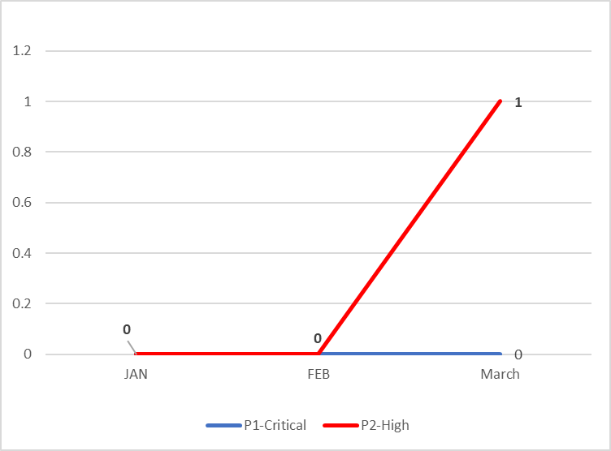
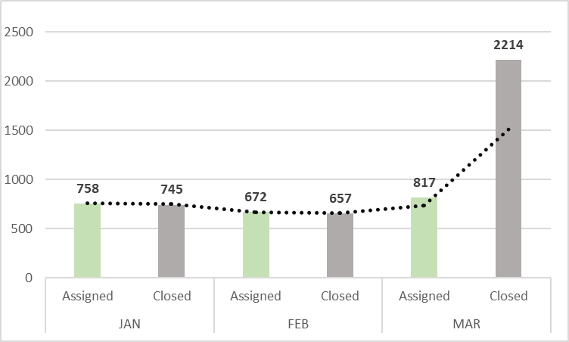
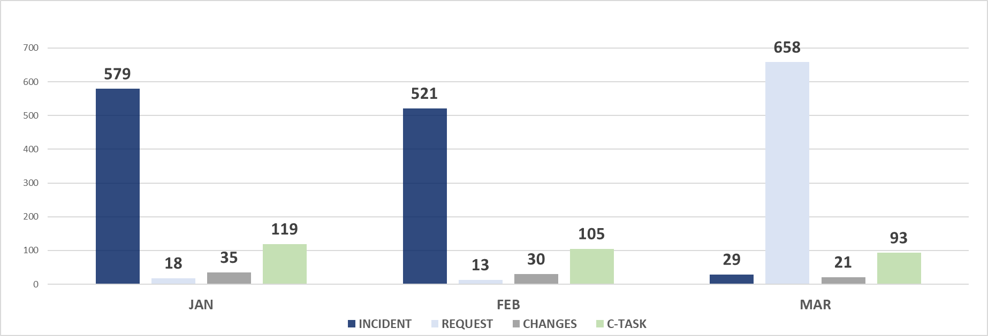
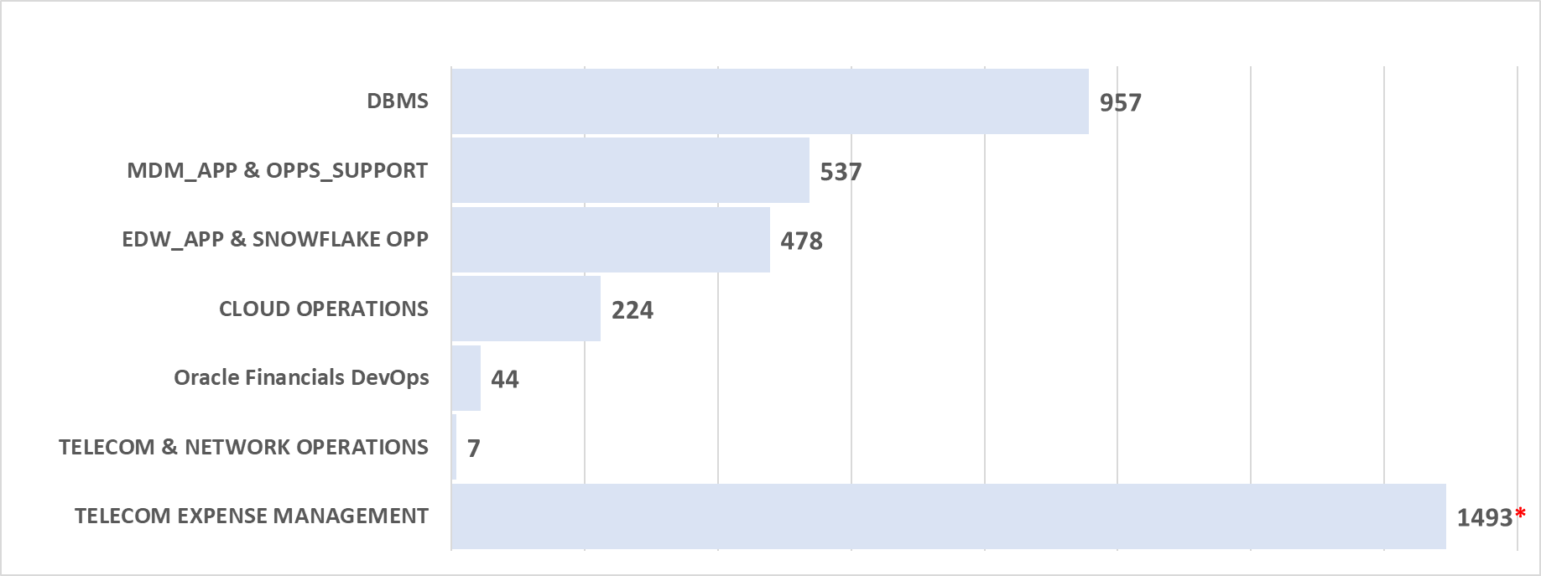
Q1 2025 - AMS PERFORMANCE SUMMARY
SLA – ACHIEVED/MET (Q1 2025 )
App Groups | RESPONSE | RESOLUTION | FTR | OTD
7 App Groups | 99.29% | 99.24% | 99.20% | 99.24%
P1/P2 Incident Trend - (Q1 2025)
Assigned Vs Closed Trend - (Q1 2025)
Tickets Assigned By Types - (Q1 2025)
Tickets By Domain - (Q1 2025)

Slide 5
DBMS Support Service – Q1 2025

Slide 6
DBMS Support Service Q1 2025 - Highlights
Business Owners/TU Leaders :
IT Ops & Apps Owner: Glenn Pereira / Vijay Tiwari
Domain Lead - Vijay Tiwari
R3 Lead – Rakesh Baratam (Oracle) / Mahesh Achanta (MS SQL Server)
Departments Supported: Across all verticals, IT/Finance/Broadcast/CISO/SCS/STR/Data/Cloud
Key Highlights :
Successfully completed Oracle Financials monthly maintenance and completed renewal of SSL certificates in all Oracle EBS instances.​
Successfully completed password rotations for all critical accounts in Oracle EBS, ADP Reports, DEAL and Rights Logic systems.​
Successfully Completed Jan-25 Security patches in DEAL and Rights Logic Databases.​
Quarterly OS security patches were successfully deployed on the production environment for MSSQL servers.
Oracle EBS - Successfully completed Java Code Sign certification and CDW Punchout certificate renewals to enable punchouts.​
DEAL and Rights Logic: Successfully completed Linux security patching in non-production environments.​
Oracle Central monitoring system: Applied latest Jan-25 security patches.​
Supported Wide Orbit Network prod application upgrade (WO Platform SWAN) .​
Annual DR test for GRIPIT Application performed successfully.

Slide 7
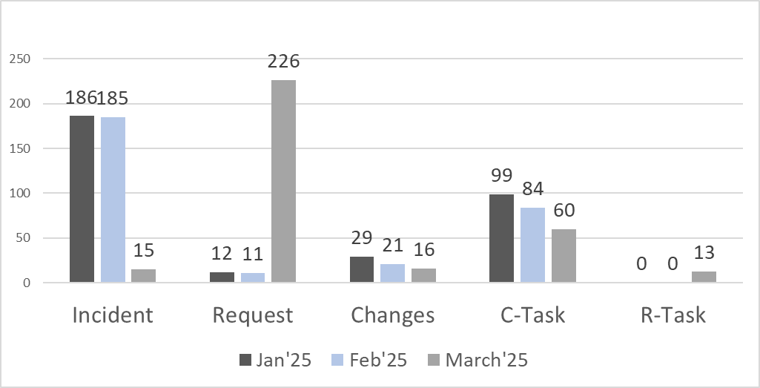
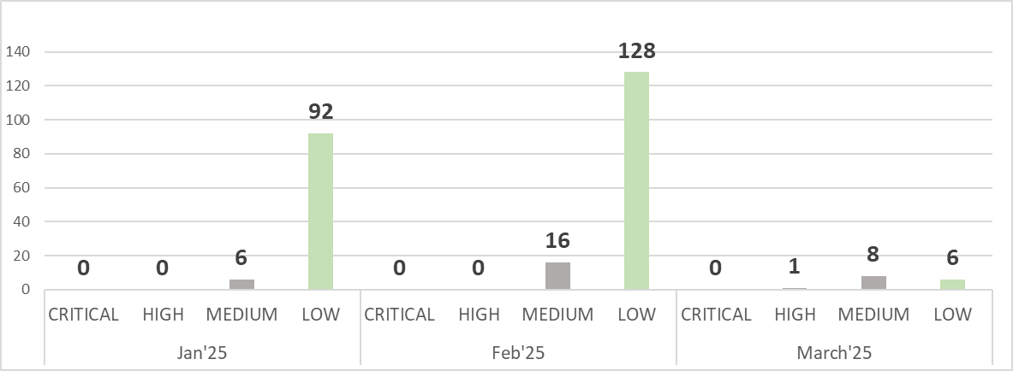
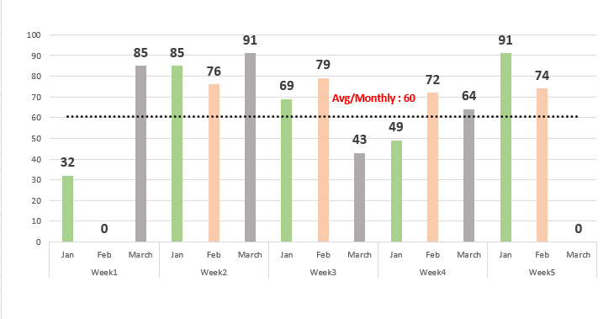
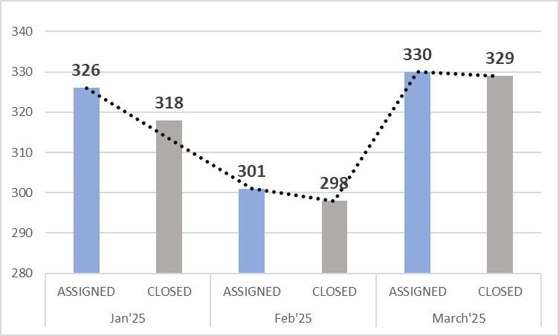
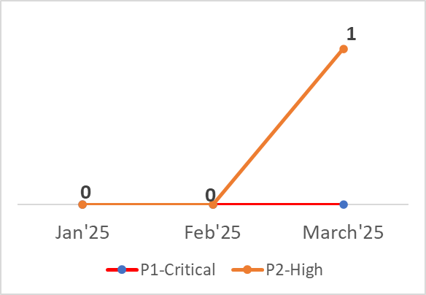
DBMS Support Service Q1 2025 -Metrics
ASSIGNED
2025
957
INCIDENT/REQUEST | CHANGES | CTASK | OTHER TASK
635 | 66 | 243 | 13
CLOSED
2025
945
INCIDENT/REQUEST | CHANGES | C-TASK | OTHER TASK
634 | 61 | 237 | 13
OPEN
TICKETS
12
INCIDENT/REQUEST | CHANGES | C-TASK | OTHER TASK
1 | 5 | 6 | 0
Total Tickets By Type(Q1 2025)
3
Incidents By Priority (Q1 2025)
Tickets Handled by Team (Monthly) - 2025
Assigned Vs Closed (Q1 2025 )
P1/P2 Incidents
SLA
Response
FTR
OTD
Resolution
99.58%
100%
100%
99.79%
Notes:
No P1/P2

Slide 8
MDM Application Support Service – Q1 2025

Slide 9
MDM Application Support Service Q1 2025 - Highlights
Business Owners/TU Leaders :
IT Ops & Apps Owner: Glenn Pereira / Vijay Tiwari
Domain Lead - Vijay Tiwari
R3 Lead – Jaya Laxmi Sunkara
Departments Supported: IT/Traffic/Finance/Sales Digital/Reporting/EIS Integrations
Key Highlights :
Completed bi-weekly server restart of MDM & IDQ maintenance in production environment . ​
Check OPV addresses on daily batch load and load them with latest last update date into MDM​.
Supported IDMC Secure agent upgrade from RHEL 7 to 9 in Production environment​.
Supported IDMC for Secure agent upgrade testing in MDM UAT environment​.
Supported EIS Pre-release major release upgrade testing in MDM UAT and Production environment​.
Supported SQL Server 2019 DB Patch CU-30(KB5049235) in lower & Production environment​.
Supported MDM integration testing for WON 2024 R0 GA4 TU1 SP1 in WON UAT environment.
Worked on the mapping mismatches and provided the report to Users to inactivate them in customer MDM​.
Prepared the recon report for OPV mapping mismatches and currently working on deploying the changes in lower environments.​
Completed MDM Verification - Annual Review IDT​.
Supported IDMC APRIL'25 Major Release Upgrade Activity in UAT environment.

Slide 10
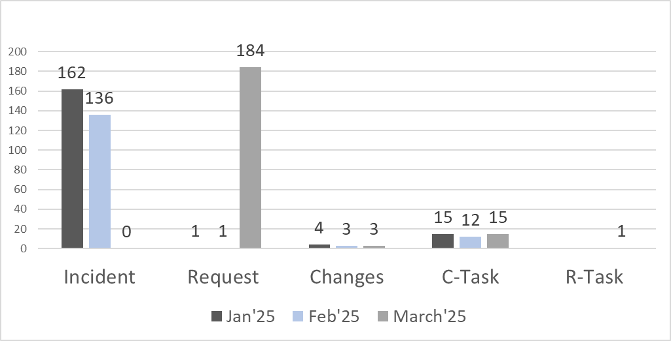
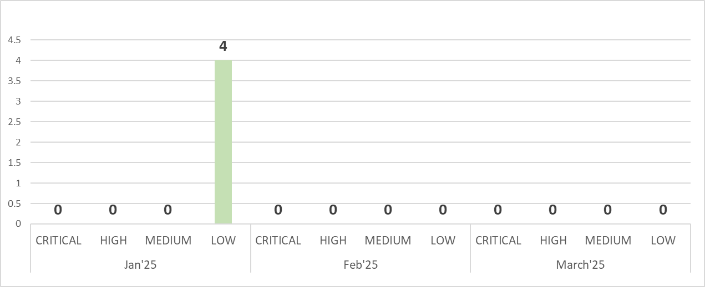
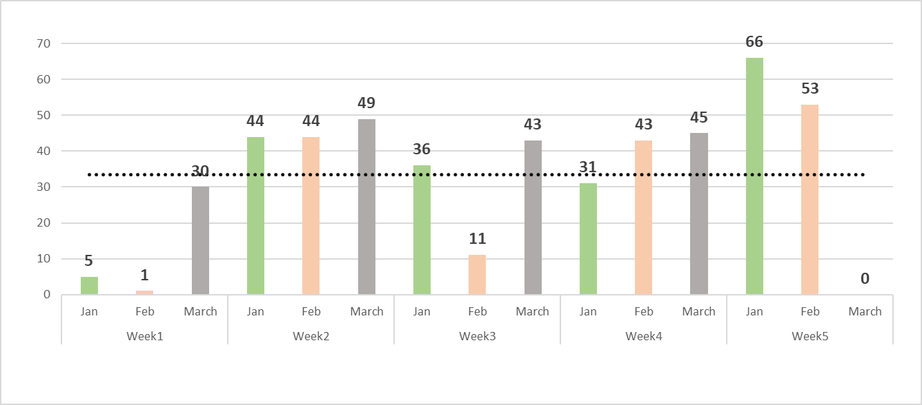
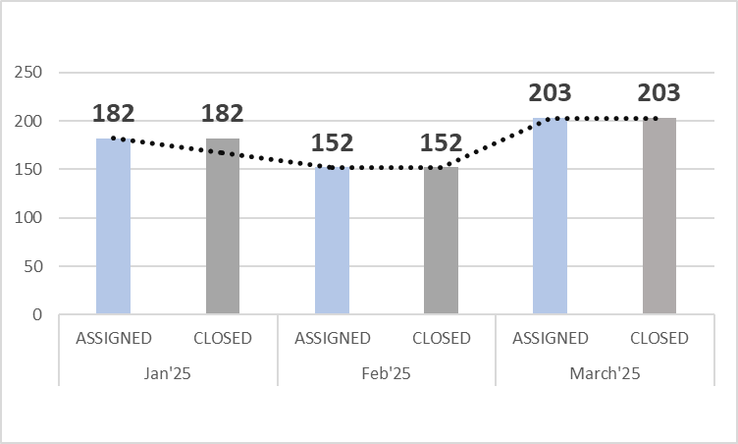
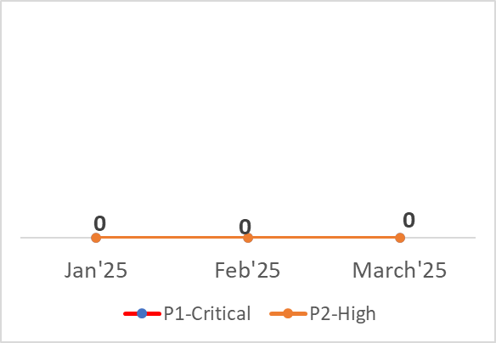
MDM Application Support Service Q1 2025 - Metrics
ASSIGNED
2025
537
INCIDENT/REQUEST | CHANGES | CTASK | OTHER TASK
484 | 10 | 42 | 1
CLOSED
2025
537
INCIDENT/REQUEST | CHANGES | C-TASK | OTHER TASK
484 | 10 | 42 | 1
OPEN
TICKETS
0
INCIDENT/REQUEST | CHANGES | C-TASK | OTHER TASK
0 | 0 | 0 | 0
Total Tickets By Type
Incidents By Priority (Q1 2025)
Tickets Handled by Team (Monthly) - 2025
Assigned Vs Closed (Q1 2025)
P1/P2 Incidents
SLA
Response
FTR
OTD
Resolution
100%
100%
100%
100%

Slide 11
EDW Application Support & Snowflake Operation Service – Q1 2025

Slide 12
EDW Application Support & Snowflake Operation Service Q1 2025 - Highlights
Business Owners/TU Leaders :
IT Ops & Apps Owner: Glenn Pereira / Vijay Tiwari
Domain Lead: Vijay Tiwari
R3 Lead – Haripriya Pothugunta
Departments supported: IT/Finance/STR(Sales Traffic and Research)/MDM/S&I(strategy & Insight)/Operative(digital Data)/ERM/SMART Upfront/DM(Dealmaker data)
Key Highlights :
The application team identified a count mismatches. To resolve this, we performed a refresh from PROD to DEV, after which the application team executed an incremental load for the failed records and applied the same fix in production.
We performed time travel for the ODS tables to resolve the count mismatch between the source and target.
The daily scheduled process was unable to drop the views during job execution. So, we manually dropped the specific view, allowing the application to restart the job from the failed step.
Performed cleanup process in AR stage and ODS tables in Snowflake in QA environment​
The application team identified a count mismatch in the PROD EBS_DM.GL_DAILY_RATES table. To resolve this, we performed a refresh from PROD to DEV, after which the application team executed an incremental load for the failed records and applied the same fix in production.​
We have completed POC for RSA Key pair authentication enable for password authenticated users/Service Account Users.​
Successfully completed the SMART UPFRONT 2024-25 season initialization.
As part of the Dealmaker Replacement project, we migrated tables and objects to QA to support the wideorbit project. ​
Stand-by support was completed during the EIS Secure Agent Upgrade cutover activity for production.

Slide 13
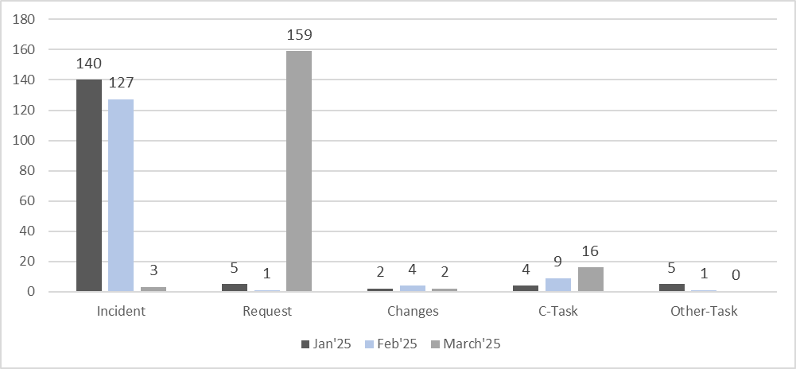
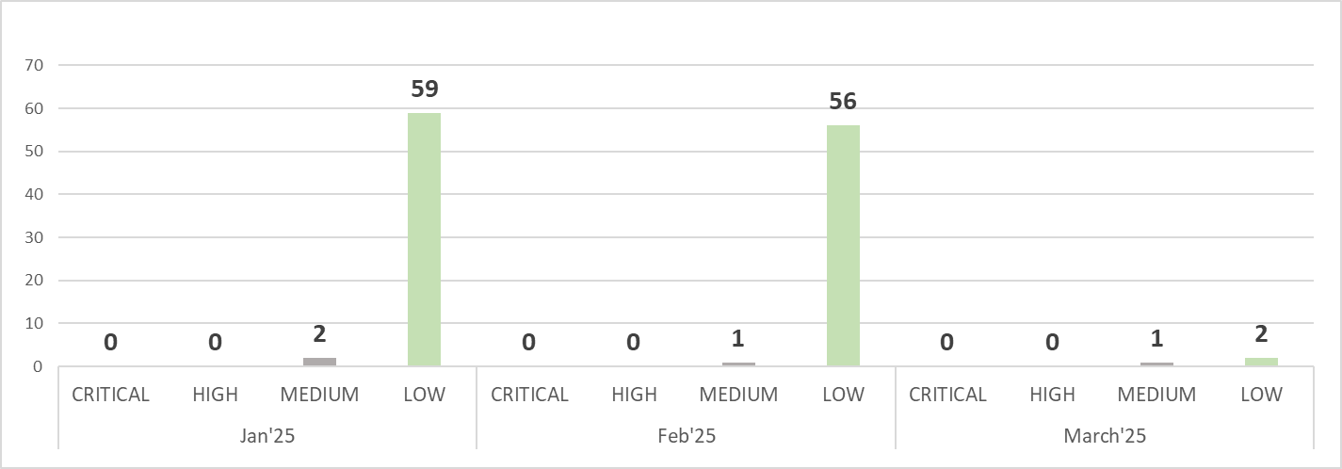
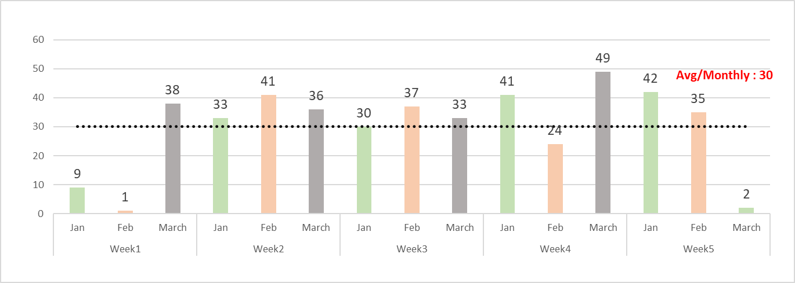
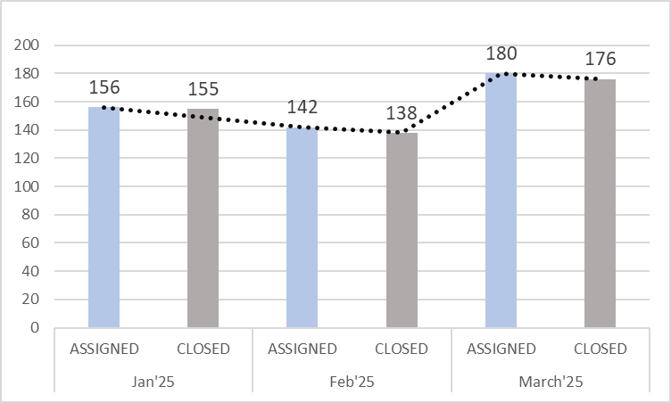
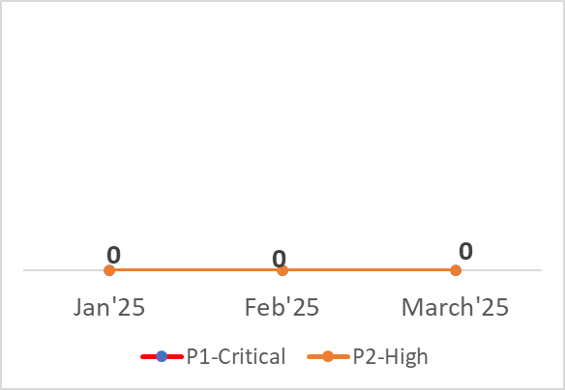
EDW Application Support & Snowflake Operation Service Q1 2025 - Metrics
ASSIGNED
2025
478
INCIDENT/REQUEST | CHANGES | CTASK | OTHER TASK
435 | 8 | 29 | 6
CLOSED
2025
469
INCIDENT/REQUEST | CHANGES | C-TASK | OTHER TASK
434 165 | 6 | 23 | 6
OPEN
TICKETS
9
INCIDENT/REQUEST | CHANGES | C-TASK | OTHER TASK
1 | 2 | 6 | 0
Total Tickets By Type
Incidents By Priority ( Q1 2025)
Tickets Handled by Team (Monthly) - 2025
Assigned Vs Closed (Q1 2025)
P1/P2 Incidents
SLA
Response
FTR
OTD
Resolution
99.37%
99%
100%
100%

Slide 14
Data Cloud Operations Service - Q1 2025

Slide 15
Data Cloud Operations Service Q1 2025 - Highlights
Business Owners/TU Leaders :
IT Ops & Apps Owner: Glenn Pereira / Vijay Tiwari
Domain Lead: Vijay Tiwari
R3 Lead : Vishnu Vardhan Reddy Yelimela
Departments Supported: Streaming, Digital, Broadcast, ViX, IT
Key Highlights :
Google Workspace license cost optimization – Workspace licenses revoked – 71, cost savings - $2556/month
Enabled NotebookLM Plus for Gemini for Google Workspace subscriptions.
Granted permissions to view GCP Billing data for Engineering team key members.​
Logical closure of Televisatim Workspace license requirements.
Progressing discussions with Google team on provisioning Google Workspace licenses for televisaunivision.com accounts.​
Implemented change to decommission GCP SAS project.​
Implemented Cloud Run tagging to allow Unauth for Media Systems GCP migration project.

Slide 16
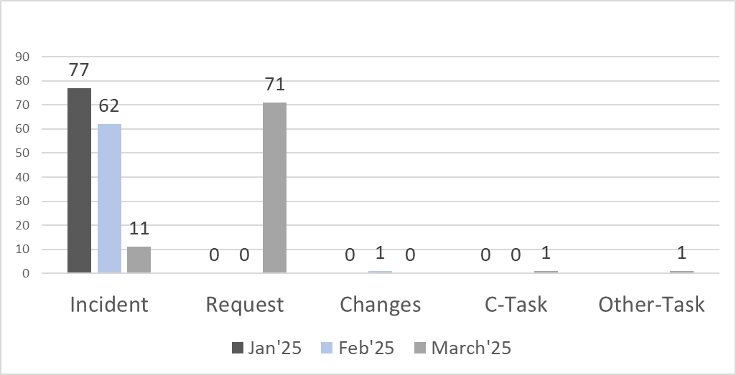
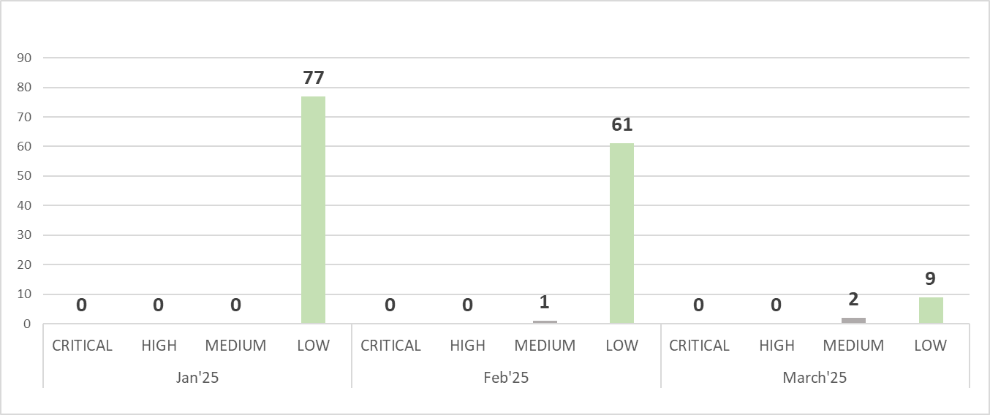
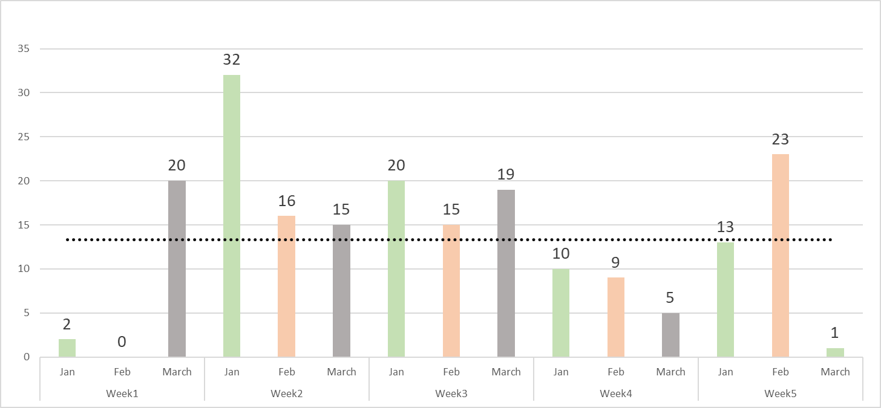
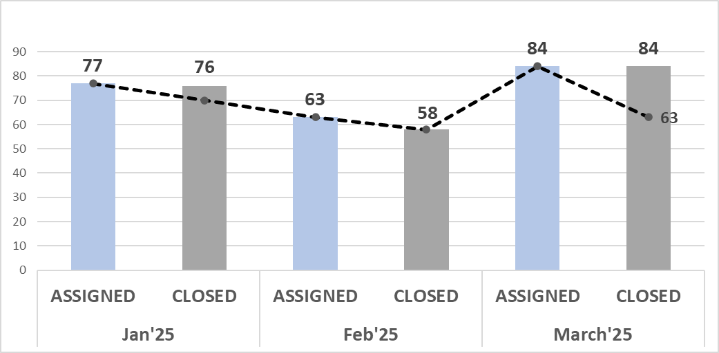
Data Cloud Operations Service Q1 2025 - Metrics )
ASSIGNED
2025
224
INCIDENT/REQUEST | CHANGES | CTASK | OTHER TASK
221 | 1 | 1 | 1
CLOSED
2025
218
INCIDENT/REQUEST | CHANGES | C-TASK | OTHER TASK
215 | 1 | 1 | 1
OPEN
TICKETS
6
INCIDENT/REQUEST | CHANGES | C-TASK | OTHER TASK
6 | 0 | 0 | 0
Total Tickets By Type
Incidents By Priority (Q1 2025)
Tickets Handled by Team (Monthly) - 2025
Assigned Vs Closed (Q1 2025)
P1/P2 Incidents
SLA
Response
FTR
OTD
Resolution
98.21%
98%
96.43%
96.43%
*As discussed, Data Cloud Operations team was using the process which was inherited from the past for handling changes. Based on leadership review, the process will be enhanced to align with other IT Ops teams.

Slide 17
Oracle Financials DevOps –Q1 2025

Slide 18
Oracle Financials DevOps Q1 2025 - Highlights
Business Owners/TU Leaders :
IT Ops & Apps Owners: Glenn Pereira / Angeles Trejo Ana Maria
Domain Leads : Ruiz Espinosa Juan Carlos, Aguilar Aguilera Alain​,
R3 Lead: Stalin Raja
Department Supported: TU Finance
Key Highlights :
Successful Optimization and tuning of the customized reports with performance related Issues ​ Report Name - XXUNV AP Details Audit Report.​
Successful deployment of New customized reports (CUSTOMER Weekly Report) in AR / AP.​
Provided support related to integration issues in all EBS environments.

Slide 19
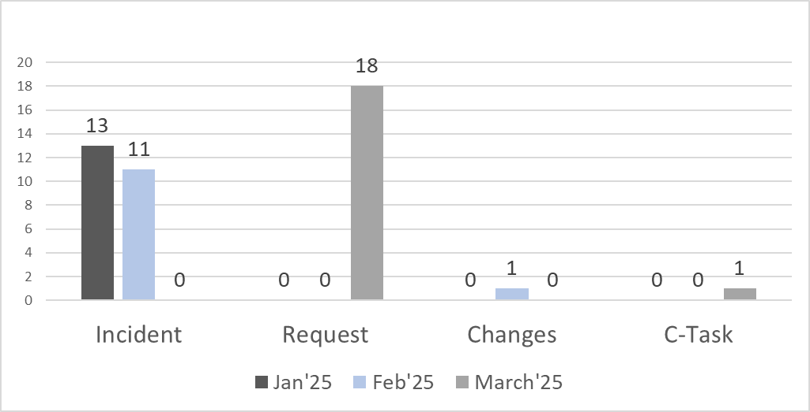
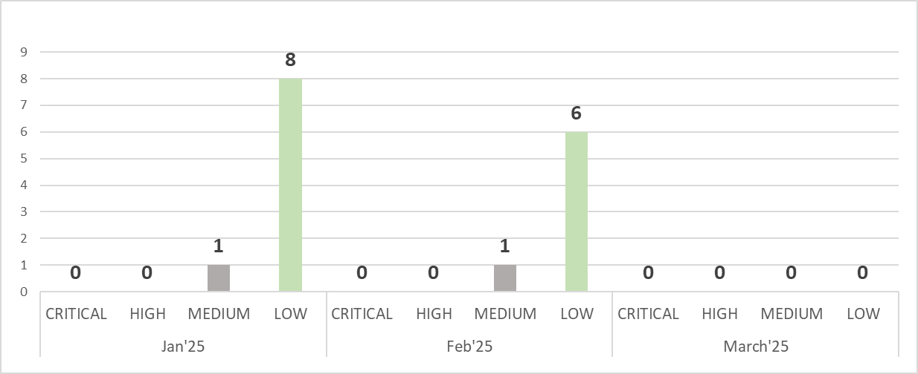
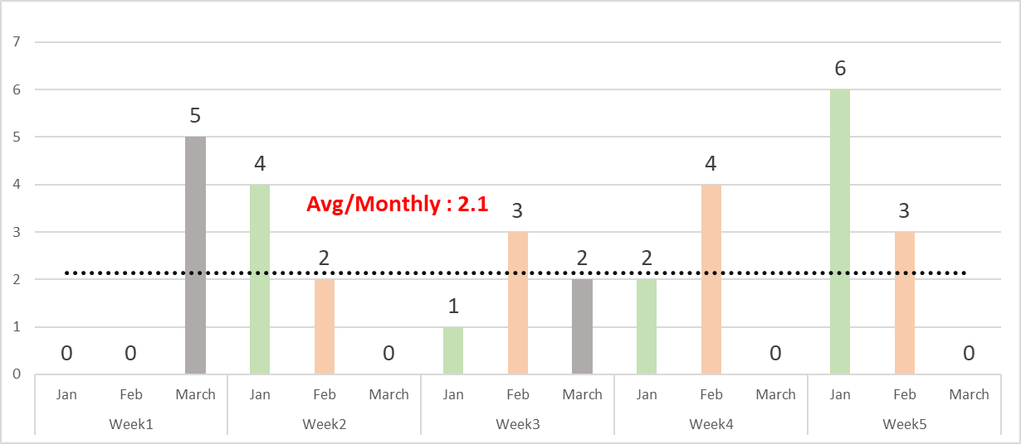
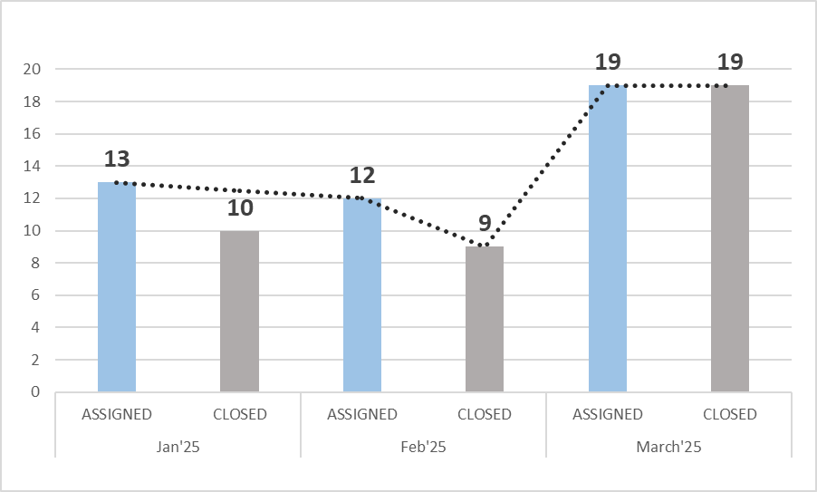
Oracle Financials DevOps Q1 2025 - Metrics
ASSIGNED
2025
44
INCIDENT/REQUEST | CHANGES | CTASK | OTHER TASK
42 | 1 | 1 | 0
CLOSED
2025
38
INCIDENT/REQUEST | CHANGES | C-TASK | OTHER TASK
36 | 1 | 1 | 0
OPEN
TICKETS
6
INCIDENT/REQUEST | CHANGES | C-TASK | OTHER TASK
6 | 0 | 0 | 0
Total Tickets By Type
Incidents By Priority (Q1 2025)
Tickets Handled by Team (Monthly) - 2025
Assigned Vs Closed (Q1 2025)
P1/P2 Incidents
SLA
Response
FTR
OTD
Resolution
95.45%
98%
88.64%
88.64%

Slide 20
Telecom Operations – Q1 2025

Slide 21
Telecom Operations Q1 2025 - Highlights
Business Owners/TU Leaders :
IT Ops & Apps Owner: Glenn Pereira / Vijay Tiwari
Domain Lead: Vijay Tiwari
R3 Lead – Hitesh Kumar
Department Supported: Across all verticals/ organizations and Mexico Call Center phone operations.
Key Highlights :
Removed unused IP Phone devices from Cisco Call Manager, which lowered down the license utilization.
Created site wise reports for IP Phone utilization across TU.
Decommissioned Singlewire Informacast paging service and saved on the renewal costs.
VMware renewal with lower core counts and saved on Operation costs.
Successfully implemented the Telethon 2025 for TU. ​
Worked on configuring the O365 migration greeting on TU mainline and sorting the call tree, with multiple vendors.​
Worked with Pexip and renewed the number of Pexip licenses from 35 to 26 end point licenses.​
Renewed Cisco Flex licenses with Cisco successfully.​
Implemented the call tree for Telethon 2025 successfully.

Slide 22
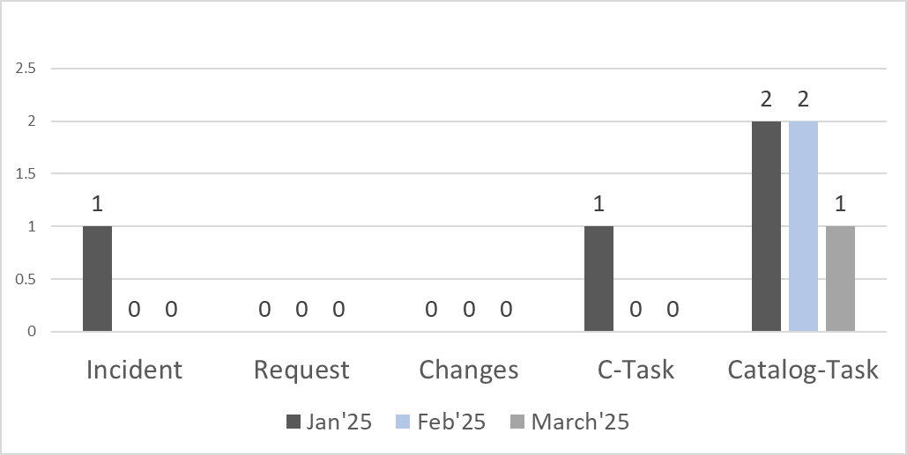

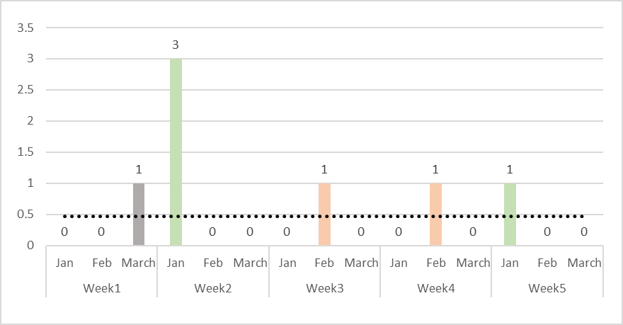
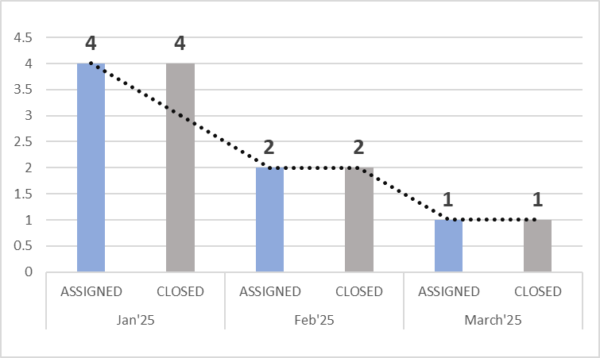

Telecom Operations Q1 2025 - Metrics
ASSIGNED
2025
7
INCIDENT/REQUEST | CHANGES | CTASK | OTHER TASK
1 | 0 | 1 | 5
CLOSED
2025
7
INCIDENT/REQUEST | CHANGES | C-TASK | OTHER TASK
1 | 0 | 1 | 5
OPEN
TICKETS
0
INCIDENT/REQUEST | CHANGES | C-TASK | OTHER TASK
0 | 0 | 0 | 0
Total Tickets By Type
Incidents By Priority ( Q1 2025)
Tickets Handled by Team (Monthly) - 2025
Assigned Vs Closed ( Q1 2025)
P1/P2 Incidents
SLA
N/A: Telecom operational tickets are handled by contracting company Continuant and they have their own SLA. Telecom only
handles Architecture and new deployment requests.

Slide 23
Telecom Expense Management Operations – Q1 2025

Slide 24
Telecom Expense Management Operations Q1 2025 - Highlights
Business Owners/TU Leaders :
IT Ops & Apps Owner: Glenn Pereira
Domain Lead: Vijay Tiwari
R3 Lead - Kiran Maddula
Departments Supported: Broadcast, Corporate, Digital Content OTT, Engineering, Finance, G&A, Legal, News and Streaming
Key Highlights :
Detected a circuit that was never activated and engaged in a dispute with the vendor, leading to a recovery of $19,414.21
Collaborated with multiple vendors to successfully complete the disconnection orders from initiation to conclusion, encompassing a total of 31 circuits
Collaborated with vendors to transition the payment method from checks to ACH, leading to faster payments to eFax and Park Place Technologies
A total of 27 invoices were identified as not having been uploaded into Oracle for payment processing. I coordinated communication between the TU Finance team and the Tangoe team to ensure timely payment for these invoices, preventing any disruption of service
Engaged with the Oracle team and internal stakeholders to complete the IDCS renewal before the deadline
New orders for the items detailed below have been finalized, including all steps from SOW validation (with Legal and S&P review and approval) to installation, invoicing, and payment
Successfully managed and finalized the HD-SDI order for the Engineering team from WABC TV to WXTV with Astound vendor
Managed and completed the order for six circuits intended for the New Year's Eve broadcast in Manhattan, NY with Verizon vendor
Successfully processed and finalized the new E-Line order for 100Mb, connecting Teaneck (NJ) to Plainview (NY) with Lightpath vendor
Engaged with the vendor and successfully completed the Internet Service project with the AT&T team at 5100 Southwest Freeway for Orlando Valdivia
Coordinated with the AT&T team and completed the set up a new U-Verse account for Jeff Schroeder at the address 875 N Michigan

Slide 25
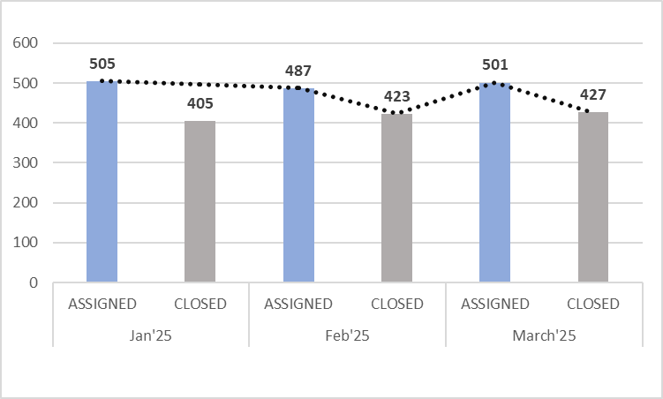
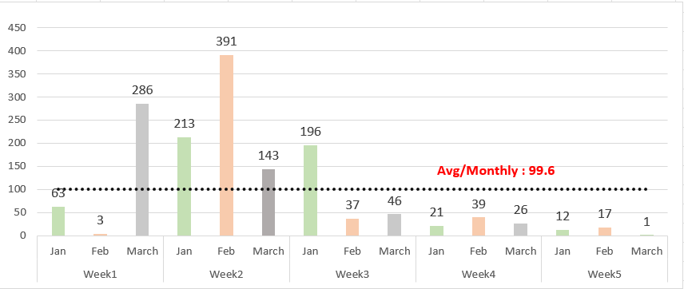
Telecom Expense Management Operations Q1 2025 - Metrics
SLA
ASSIGNED INVOICES
2025
1493
Response
Resolution
CLOSED INVOICES
2025
1255
100%
100%
OPEN INVOICES
238
Assigned Vs Closed (Q1 2025)
Invoices Handled by Team (Monthly) 2024
*Invoice metrics are from Rivermine

Slide 26
SLA, OTD & FTR Definitions
Incident SLA:
Priority Response SLA Resolution SLA
P1 15 Min (24 X 7) 2 Hours (24 X 7)
P2 2 Hours (24 X 7) 8 Hours (24 X 7)
P3 4 Hours (24 X 7) 2 BD (During Standard Local Hours)
P4 2 BD (During Standard Local Hours) 3 BD (During Standard Local Hours)
Response Time SLA– Measured from the time the incident is assigned to R3TEK and the time in which R3TEK responds to the customer.
Resolution Time SLA - Measured from the time the incident is assigned to R3TEK and the incident resolution. If the incident is not resolved within the defined timeframe, the continuous effort will be applied until the incident is resolved.
Request SLA:
Request Priority Response SLA Resolution SLA
R1 15 Min (24 X 7) 2 Hours (24 X 7)
R2 2 Hours (24 X 7) 8 Hours (24 X 7)
R3 4 Hours (24 X 7) 2 BD (During Standard Local Hours)
R4 2 BD (During Standard Local Hours) 3 BD (During Standard Local Hours)
OTD – On-Time Delivery. A Request SLA (10 Business Days)) attaches to the ticket assigned to R3TEK support person.
FTR - First Time Right. It is calculated at the time of resolving the ticket. If the resolved ticket is reopened within 3 days from the date of resolution then FTR is breached.

Slide 27
Q1 2025 – SLA Report - ACHIEVED by all App Groups
END DATE | APP GROUP | RESPONSE % | RESOLUTION % | FTR % | OTD %
 | SLA Threshold | 99.29% | 99.24% | 99.20% | 99.24%
03/31/2025 | Database Management Service | 99.58% | 99.79% | 100% | 99.79%
03/31/2025 | MDM Application Support | 100% | 100% | 100% | 100%
03/31/2025 | EDW Application & Snowflake Operations Support | 99.37% | 100% | 100% | 100%
03/31/2025 | Data Cloud Operations | 98.21% | 96.43% | 98% | 96.43%
03/31/2025 | Oracle Financials DevOps# | 95.45%# | 88.64%# | 98% | 88.64%
03/31/2025 | Telecom Operations | N/A* | N/A* | N/A* | N/A*
03/31/2025 | Telecom Expense Management | 100% | 100% | N/A* | N/A*
* N/A: Telecom operational tickets are managed by the contracting company, Continuant, which has its own SLA. Telecom (R3TEK) is responsible solely for Architecture and new deployment requests.
# For Oracle Financials DevOps, most of the cases we handle are requests rather than actual incidents.

Slide 28
DBMS/MDM/EDW/Cloud OPS/Oracle Financials/Telecom/TEM Vertical Counts
DBMS
EDW
Oracle Financials
Telecom Expense Mgmt.
Databases – 38
Applications – 10
Queries Processed _~ 900K/Monthly
GCP Projects –300+
Departments –5
Modules- 2
Customization - 25
Integrations - 25
Servers - 35
Applications - 10
Invoices assigned - 6033
Closed/Payment processed –
5468
Databases –132
Applications –39
MDM
Data Cloud
Telecom

Slide 29
Questions & Answers
?
A

Slide 31


THANK YOU !

